Slide 1
BRIGHT TV
Audience & Growth
Insights Report
User behaviour, content performance, and recommendations
to grow consumption and audience reach.

Slide 2
BRIGHT TV
Agenda
2 / 14
What we will cover
A 20-minute walkthrough of the data, the story it tells, and the actions it suggests.
01
Dataset & Methodology
02
Who is watching Bright TV
What we analysed and how.
Demographics, geography, and reach.
03
When and how they watch
04
What drives consumption
Day-of-week, daypart, and session patterns.
Factors influencing viewing time.
05
Content for low-consumption days
06
Initiatives to grow the user base
Programming recommendations.
Strategic recommendations.
Bright TV | Audience Insights | Jan–Mar 2016

Slide 3
BRIGHT TV
01 · Dataset & Methodology
3 / 14
Dataset at a glance
viewing logs across DStv channels carried by Bright TV.
1,000
415
18
9
Viewing sessions analysed
Unique users
Channels tracked
Provinces covered
Variables captured
How we read it
User: ID, age, age group, gender, race, province
Session: date, time, hour, day of week, daypart, month
Content: channel watched
Engagement: session duration in seconds
Aggregated total minutes by day, hour and channel
Segmented by demographic and geographic cohorts
Identified peak and trough patterns
Cross-referenced channels with low-consumption windows
Bright TV | Audience Insights | Jan–Mar 2016

Slide 4
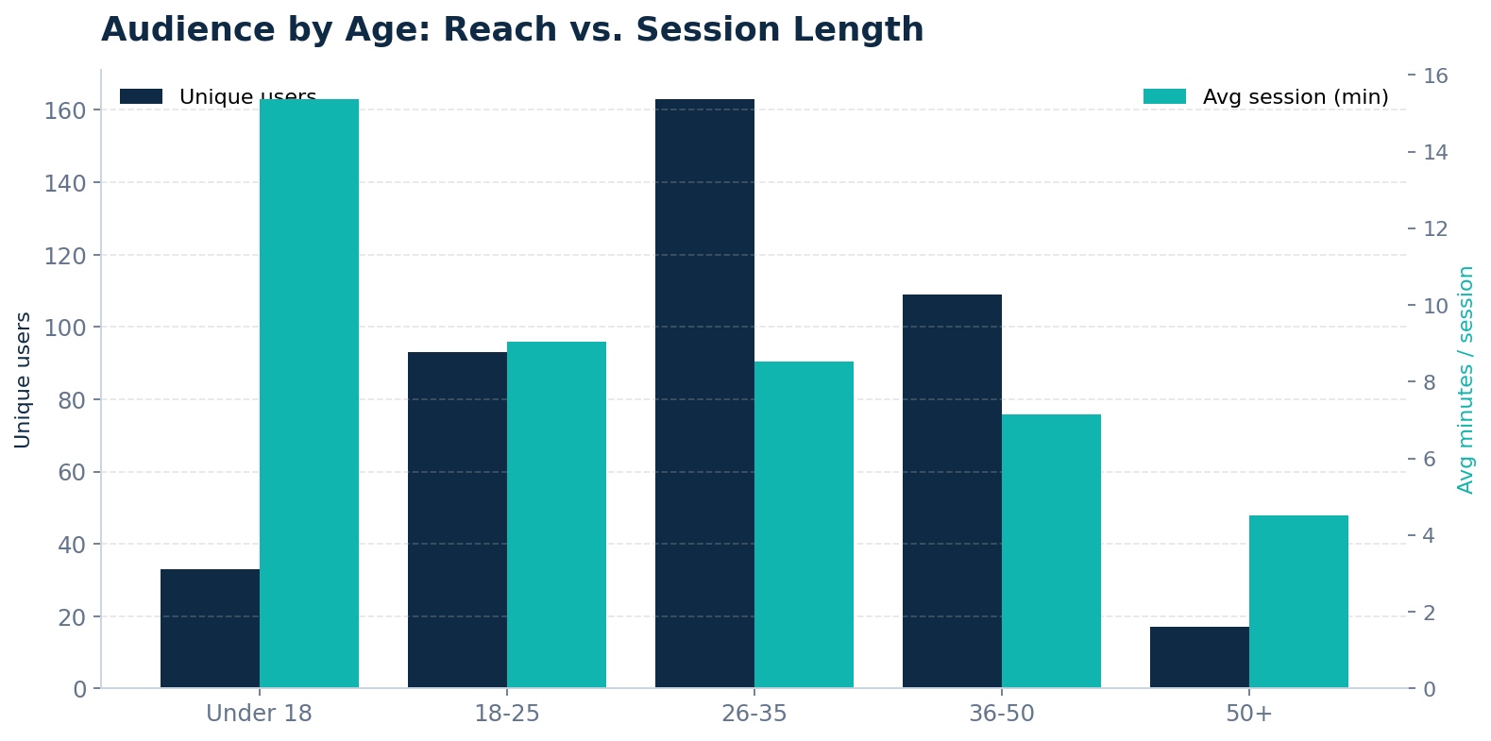
BRIGHT TV
02 · Audience
4 / 14
Who is watching Bright TV
A predominantly young, male, urban audience , but children watch the longest.
Key takeaways
26–35 is the largest cohort (37%)
89% of viewers are male — strong skew
Under-18s watch the longest sessions (15 min avg)
50+ segment is small (4%) and quick to leave

Slide 5
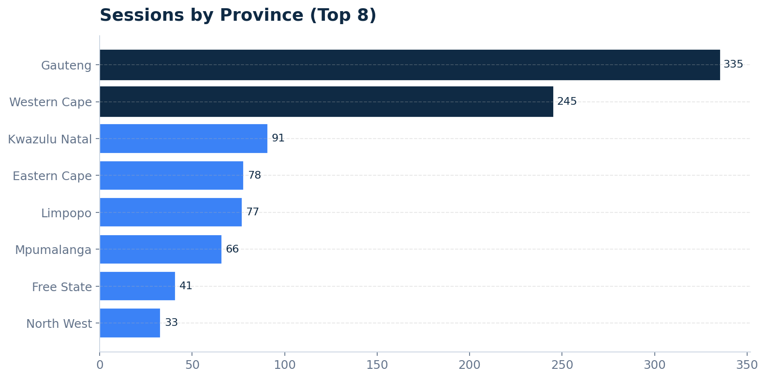
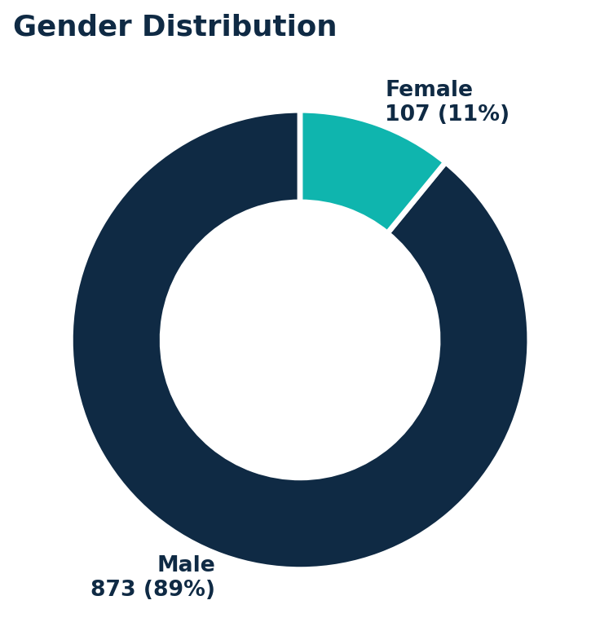
BRIGHT TV
02 · Audience
5 / 14
Where they watch from
Two provinces drive the majority of viewing .
58% of sessions come from Gauteng + Western Cape
Bright TV | Audience Insights | Jan–Mar 2016

Slide 6
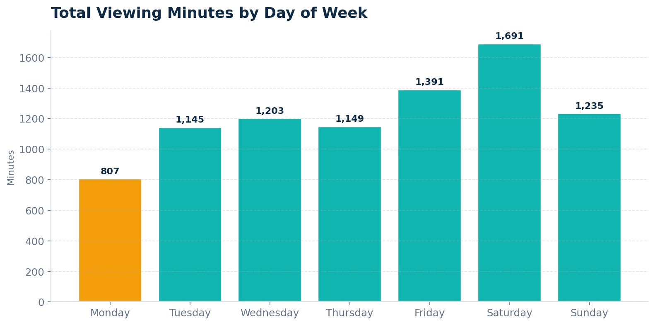
BRIGHT TV
03 · When they watch
6 / 14
Weekend wins, Monday lags
Saturday delivers 2× the viewing minutes of Monday , a clear consumption gap.
Insight
Saturday peaks at 1,692 min
Monday follows at 807 min
Weekend = 30% of total viewing
Mon–Thu represents the biggest growth opportunity

Slide 7
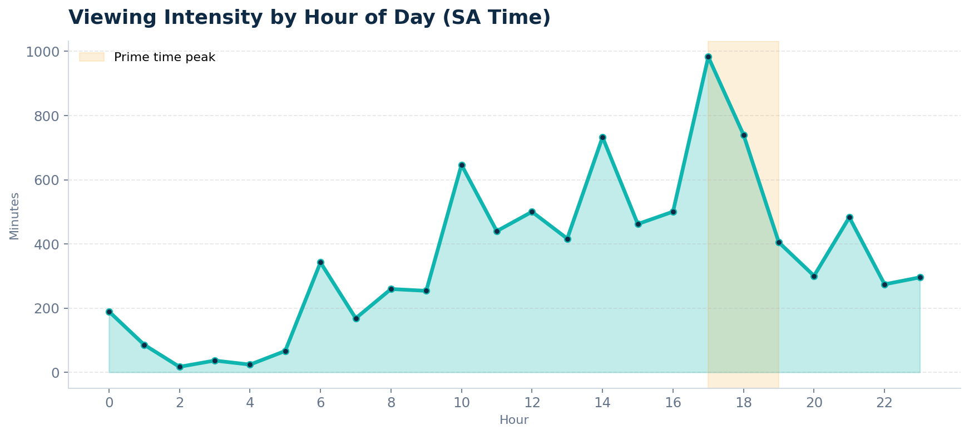
BRIGHT TV
Prime time is 5–7 PM
A clear evening peak, with secondary spikes mid-morning and early afternoon.
Peak hours
17:00 – 19:00
Avg session: ~14 min
Quietest window
02:00 – 05:00
< 2% of total minutes

Slide 8
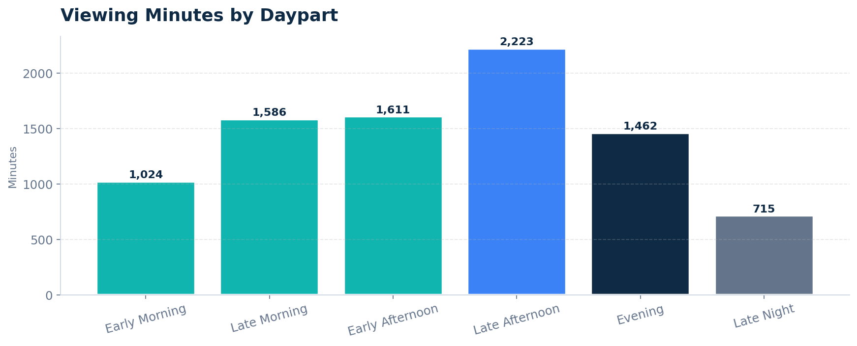
BRIGHT TV
03 · When they watch
8 / 14
Daypart distribution
Late Afternoon and Evening together account for 50% of viewing.
What it means
Evening drives volume
Late Morning is a hidden 2nd peak (likely school-out / home audience)
Late Night is small but engaged niche super-fans
Early Morning under-served

Slide 9
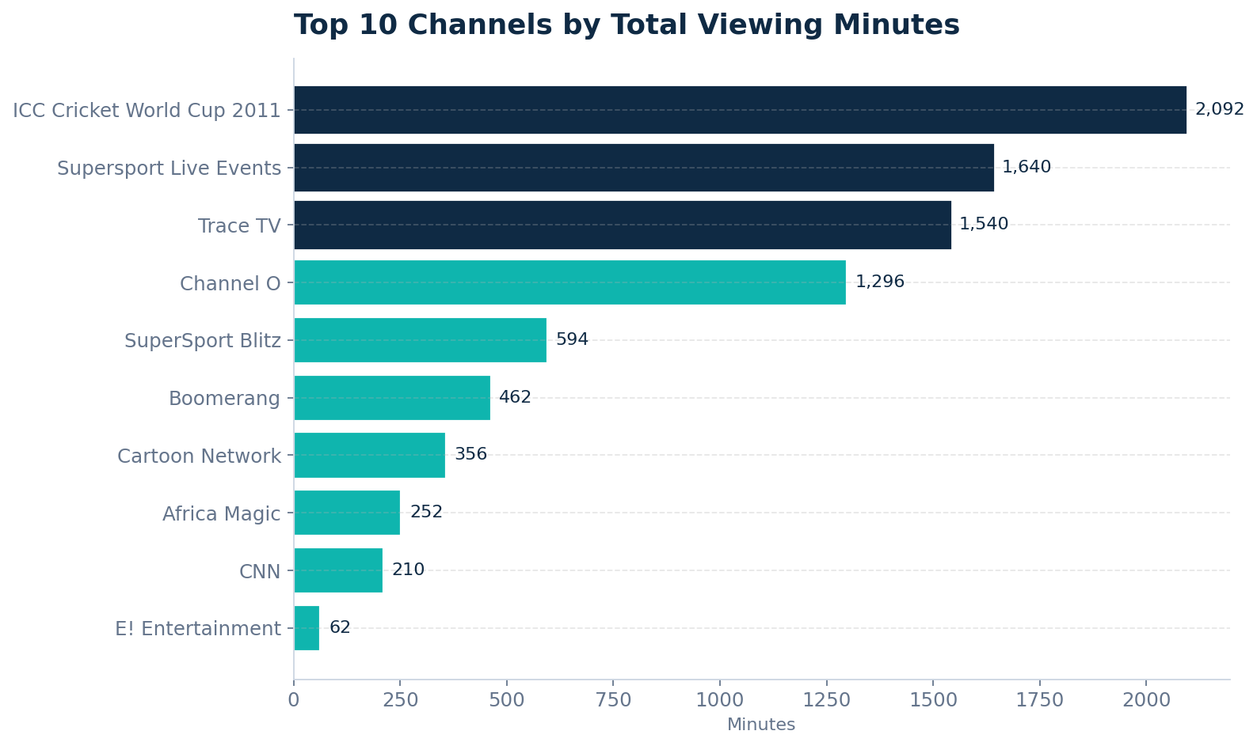
BRIGHT TV
04 · Content performance
9 / 14
Sport and music dominate
Live sport and music channels capture 70% of total viewing minutes.
Top performers
ICC Cricket World Cup 2011 — 2,093 min
Supersport Live Events — 1,641 min
Trace TV (music) — 1,541 min
Channel O (music) — 1,297 min
Boomerang & Cartoon Network bring kids

Slide 10
BRIGHT TV
04 · Factors influencing consumption
10 / 14
What drives Bright TV viewing
Five clear levers emerge from the data.
1
Live sporting events
Cricket World Cup & Supersport account for the largest share of minutes — events create appointment viewing.
2
Day of week
Weekends drive 2× the volume of early-week days — leisure time is the strongest predictor.
3
Daypart (evening prime)
17:00–19:00 is the high-intensity window — aligned with end-of-work / family viewing.
4
Age & life stage
Under-18s post the longest sessions; 26–35 deliver the most volume; 50+ disengage quickly.
5
Geography
Urban provinces (Gauteng, Western Cape) over-index — connectivity and infrastructure matter.
Bright TV | Audience Insights | Jan–Mar 2016

Slide 11
BRIGHT TV
05 · Lifting low-consumption days
11 / 14
Programming for Monday–Thursday
Re-engineer the weekday line-up around what already works on weekends.
Monday Night Sport
Music + Lifestyle blocks
Kids "After-School" hour
Live football / cricket fixtures or curated weekend highlights to extend the Saturday halo.
Trace TV & Channel O specials in the 17:00–19:00 prime window to capture the evening peak.
Boomerang & Cartoon Network bundle 14:00–17:00 — Under-18s show the longest sessions.
Weekly tent-pole shows
Catch-up & marathon nights
Localised SA content
Africa Magic & M-Net weekly drama drops to create appointment viewing midweek.
Tuesday / Wednesday late-evening reruns of weekend live events for missed audiences.
kykNET, MK and Vuzu local programming to deepen relevance for Gauteng / Western Cape core.
Bright TV | Audience Insights | Jan–Mar 2016

Slide 12
BRIGHT TV
06 · Growing the user base
12 / 14
Initiatives to grow Bright TV
Six plays — combining audience expansion, product, content and partnerships.
Close the gender gap
Expand beyond Gauteng / WC
Capture the 50+ segment
Female viewers are only 11%. Commission lifestyle, drama and reality blocks aimed at women 25–44.
Run KZN, Eastern Cape and Limpopo activations with localised content and language options.
Partner with news, faith and heritage channels; simplify navigation and on-screen guides.
Mobile-first product
Live sport rights bundles
Referral & loyalty programme
Lightweight Android app + WhatsApp programme guide for low-data, low-cost viewing on the go.
Sport drives engagement. Secure complementary leagues (PSL, rugby) to extend the sport halo.
Reward existing users for sign-ups; partner with telcos for data bundles tied to viewing time.
Bright TV | Audience Insights | Jan–Mar 2016

Slide 13
BRIGHT TV
Summary
13 / 14
Key takeaways
One page — what we learned and what to do next.
What we learned
What to do
Audience: young, male, urban — Gauteng/WC heavy
Sport + music + kids = 80%+ of viewing
Saturday peaks; Monday is the weakest day
Prime time 17:00–19:00; second peak late morning
Under-18s most engaged per session; 50+ least
Re-engineer Mon–Thu line-up around sport, music & kids
Lock prime-time 17:00–19:00 with tent-pole programming
Commission female-skewed content to close the gender gap
Expand reach beyond two provinces with local content
Launch mobile-first product + telco data partnerships
Bright TV | Audience Insights | Jan–Mar 2016

Slide 14
Thank you
Questions & discussion
Bright TV • Audience Insights • Q1 2016

